Slide 1
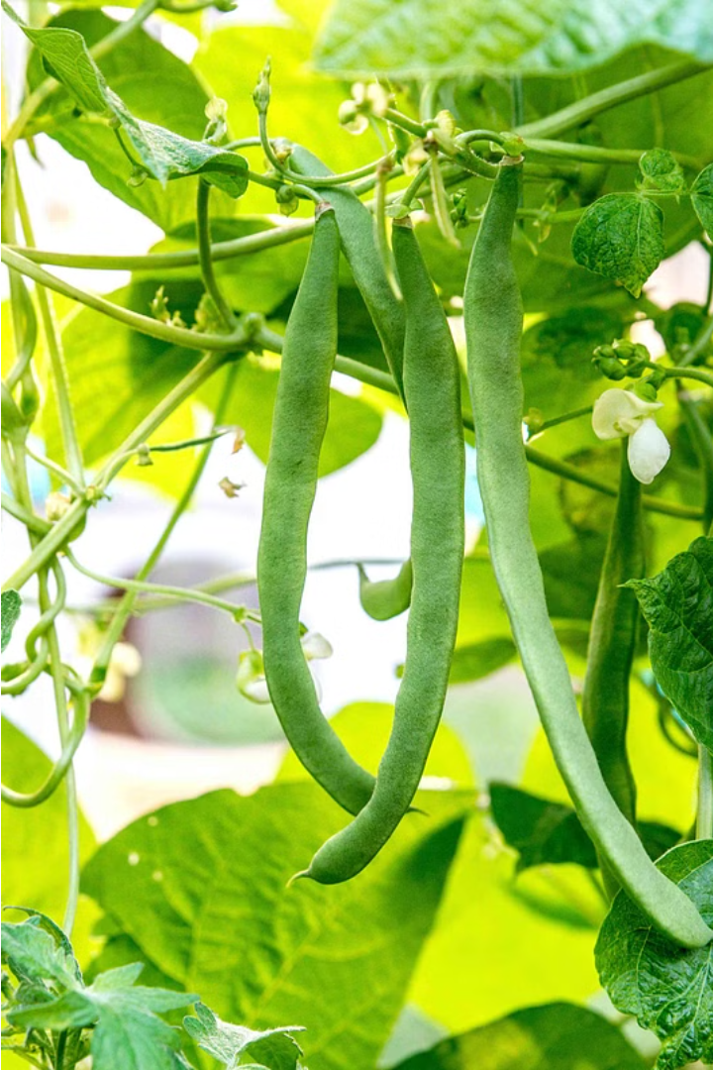

A Comprehensive Agricultural Intelligence Platform For Beans
BeanCare is an intelligent platform that empowers bean farmers with valuable insights to improve their operations and yields. Developed in 2024, this comprehensive system aims to revolutionize the way bean farmers approach their cultivation and business strategies.
2024 - 24 - 103

Slide 2
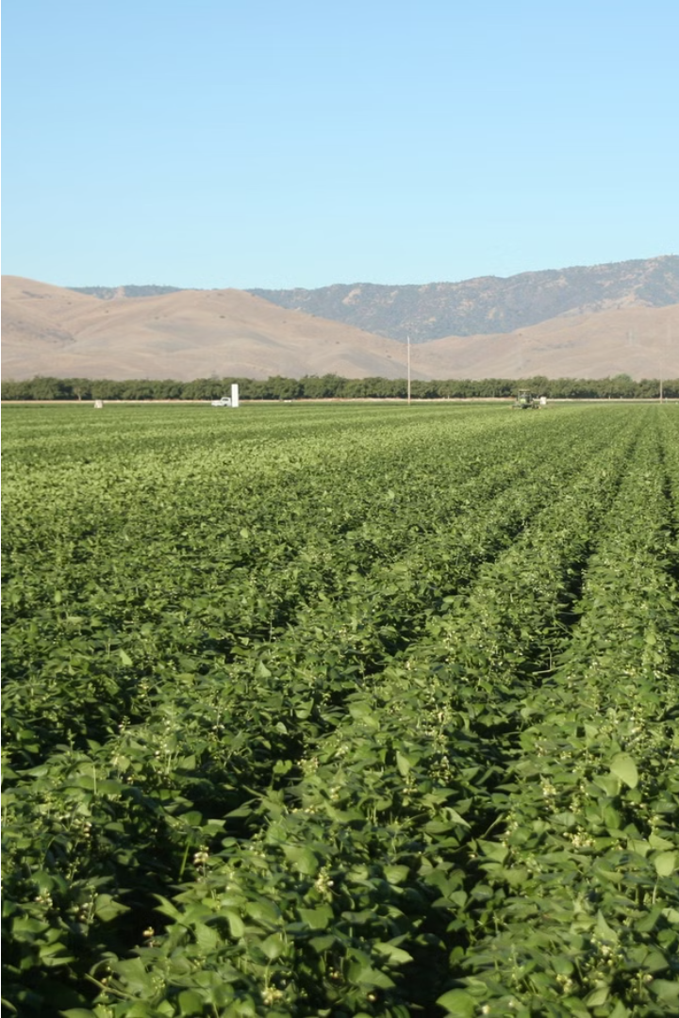
Introduction
This project aims to develop an intelligent platform that empowers bean farmers with valuable insights to improve their operations and yields.

Slide 3
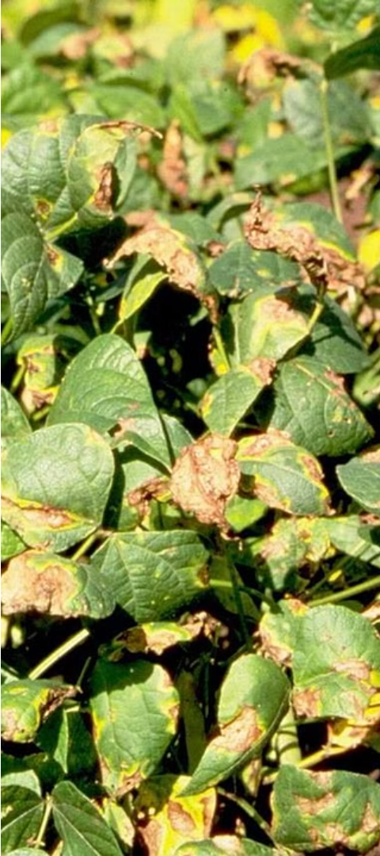
Problem Statement
1
Disease Detection
2
Price Prediction
Early identification of bean pod and leaf diseases is crucial for timely treatment.
Accurate forecasting of retail and wholesale bean prices helps farmers plan their sales.
3
Weather Forecasting
Reliable weather predictions enable farmers to optimize cultivation and harvesting schedules.

Slide 4
System Architecture
Machine Learning
Models
Comprehensive Support
The platform integrates machine learning models for disease detection, price forecasting, and weather prediction to provide comprehensive support for bean farmers.
The platform utilizes advanced machine learning models to tackle the key challenges faced by bean farmers.
The system aims to provide a comprehensive suite of tools and insights to empower bean farmers and improve their operations.

Slide 5




Technologies and Tools
Python
TensorFlow
Flask
OpenCV
The primary programming language used in the development of the platform.
The open-source machine learning framework used for model development.
The web framework used for building the platform's user interface and API.
The computer vision library used for image processing and analysis.

Slide 6
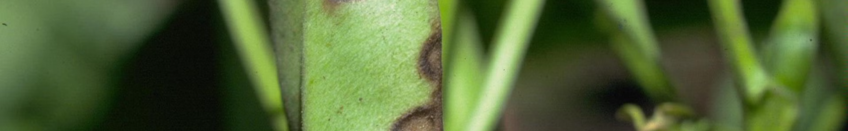
Bean Pod Disease Diagnosis
Example Images
Model Architecture
The example images showcase various bean pod diseases as well as healthy bean pods.
The model architecture used for bean pod disease diagnosis is InceptionResNetV2.
1
2
3
Code Snippet
The code snippet showcases the model loading and inference functions for bean pod disease diagnosis.
IT20647100 | Perera M.T.G.E | 2023 - 24 - 103

Slide 7
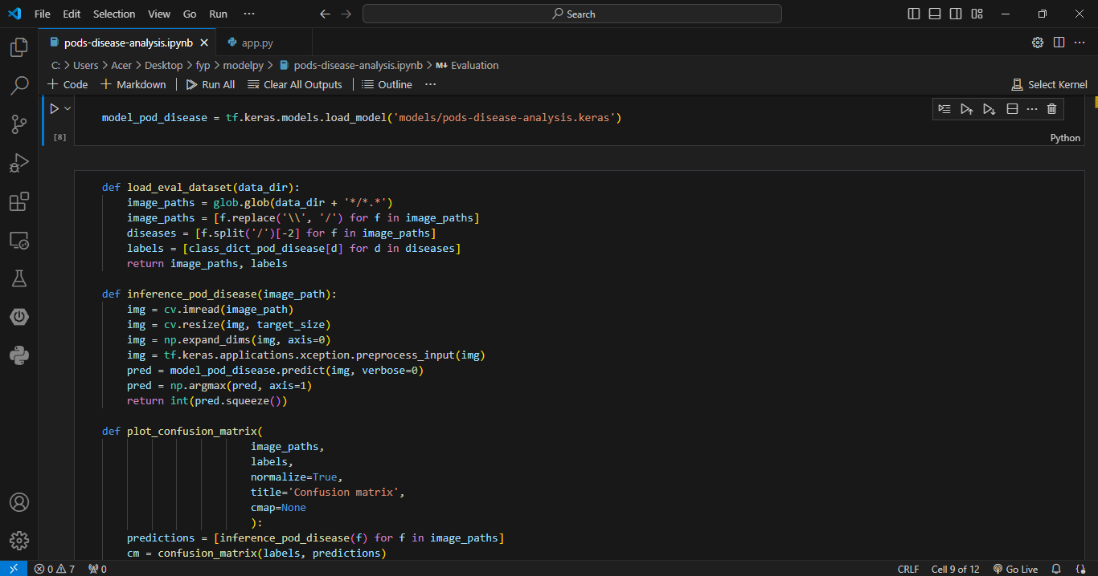

Model Loading and Prediction Functions
IT20647100 | Perera M.T.G.E | 2023 - 24 - 103

Slide 8
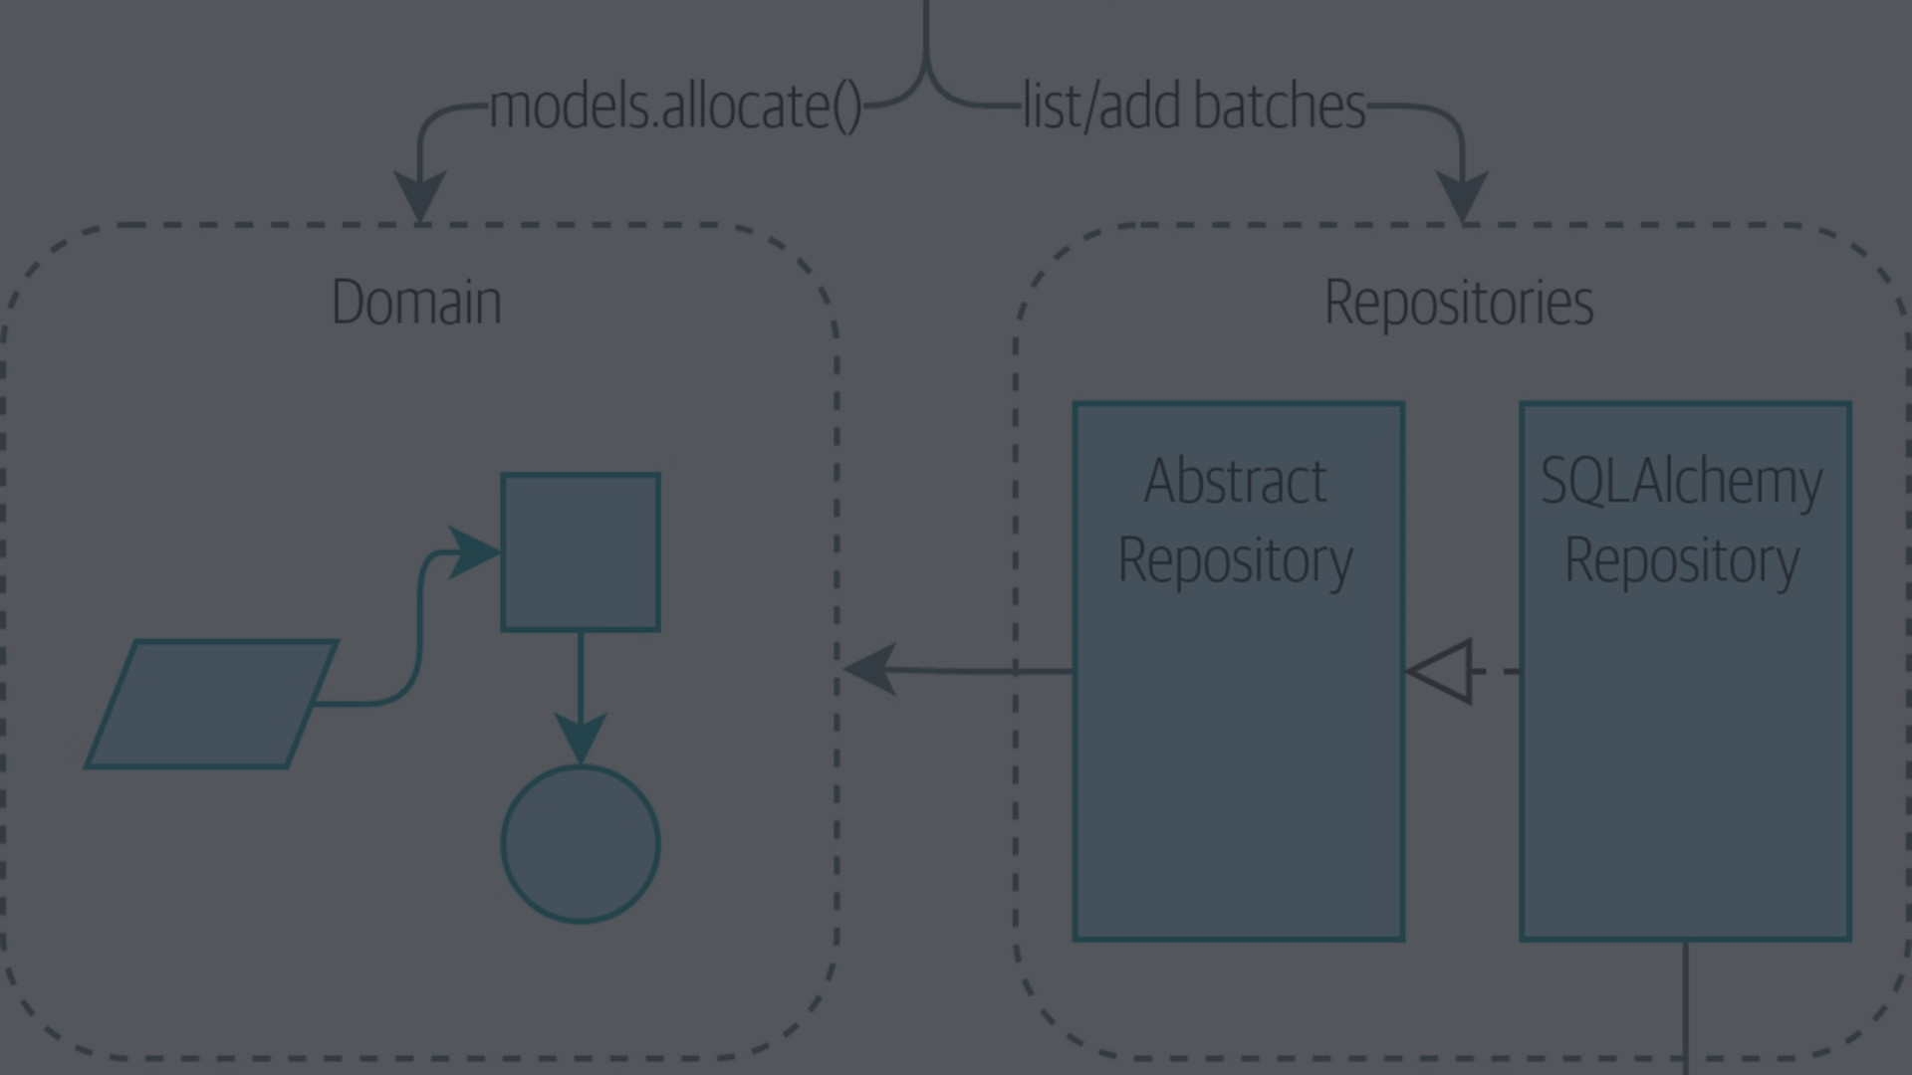
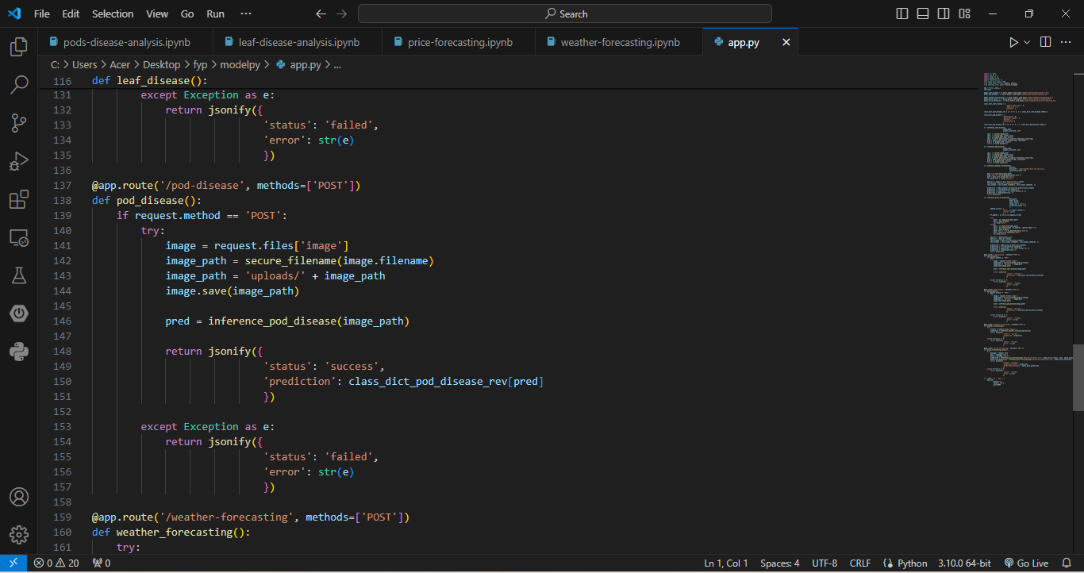
Flask API Endpoints
IT20647100 | Perera M.T.G.E | 2023 - 24 - 103

Slide 9
Bean Leaf Disease Diagnosis
Xception
Model Loading
Prediction
The bean leaf disease diagnosis system utilizes the Xception model architecture to accurately identify various diseases affecting bean leaves.
The code snippet demonstrates the functions for loading the pre-trained model and performing inference on input images.
Example images showcase the different types of bean leaf diseases as well as healthy leaves, allowing for comprehensive diagnosis capabilities.
IT20299170 | Subasinghe H.K.A.AS | 2023 - 24 - 103

Slide 10
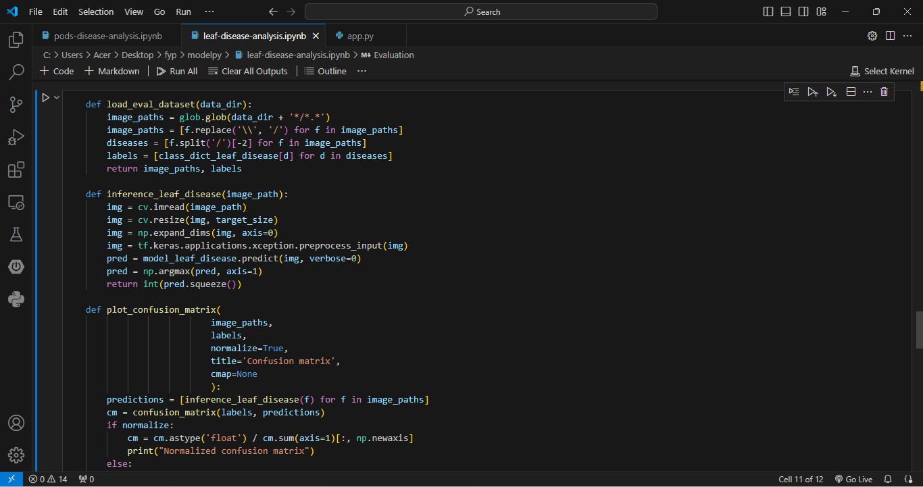
Model Loading and Prediction Functions
IT20299170 | Subasinghe H.K.A.AS | 2023 - 24 - 103

Slide 11
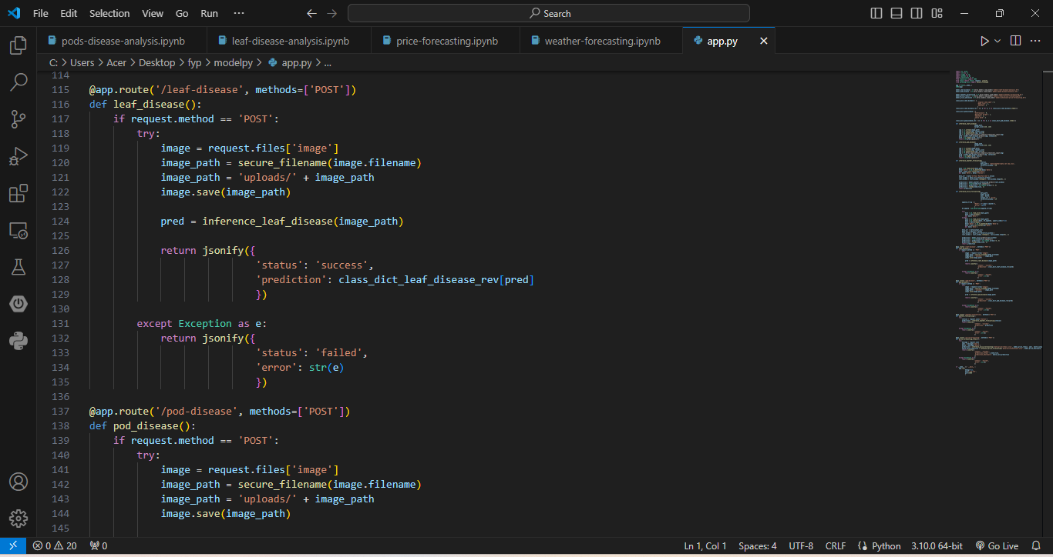
Flask API Endpoints
IT20299170 | Subasinghe H.K.A.AS | 2023 - 24 - 103

Slide 12
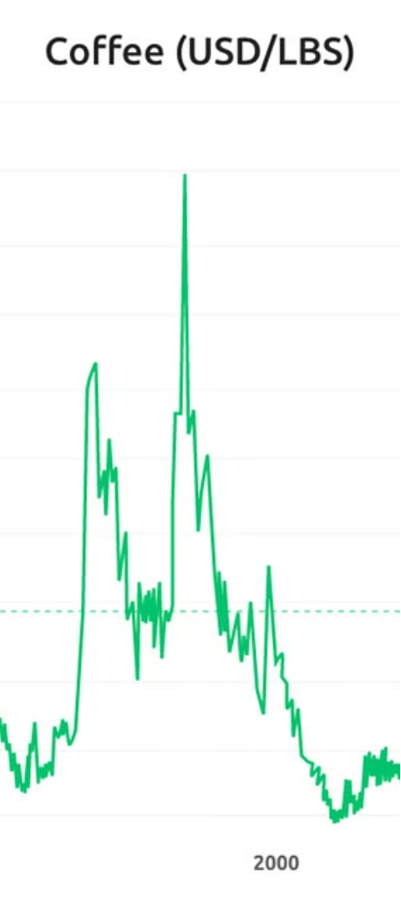

Price Prediction Module
1
Model Architecture
The price prediction module utilizes an LSTM (Long Short-Term Memory) model architecture to forecast bean prices.
2
Code Snippet
The code snippet showcases the functions for loading the pre-trained model and making price predictions.
3
Graphs
The graphs display historical price trends and predicted future prices, providing valuable insights for bean farmers.
IT20119362 | Bandara Higgoda T.T.S | 2023 - 24 - 103

Slide 13
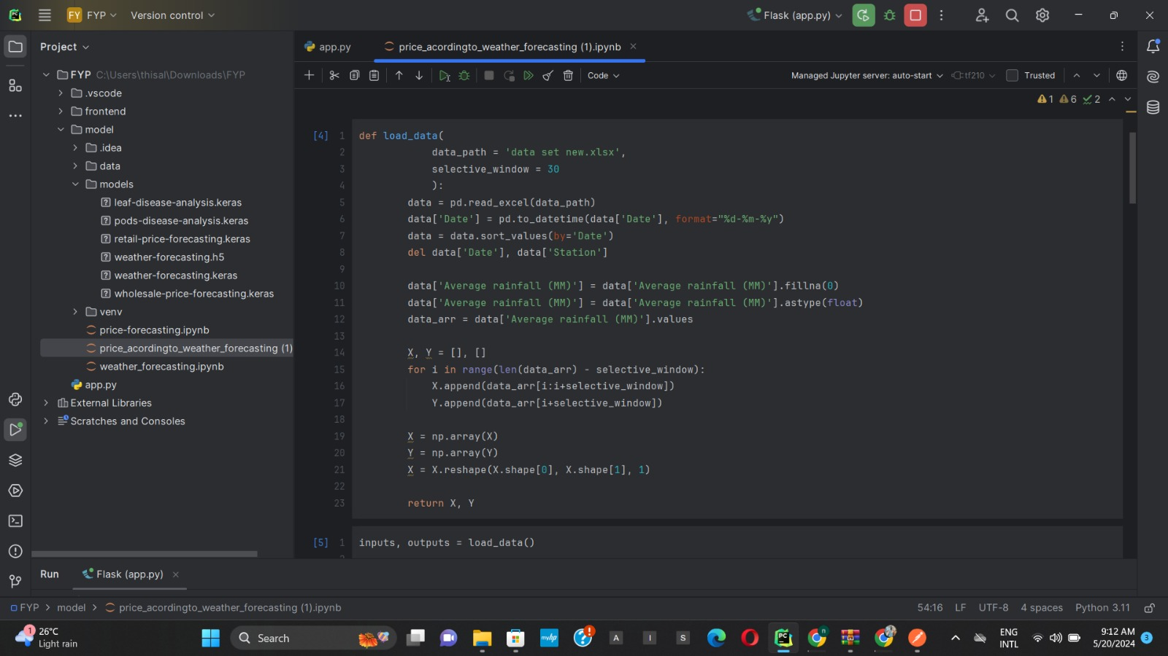
Data loading and preprocessing function
IT20119362 | Bandara Higgoda T.T.S | 2023 - 24 - 103

Slide 14
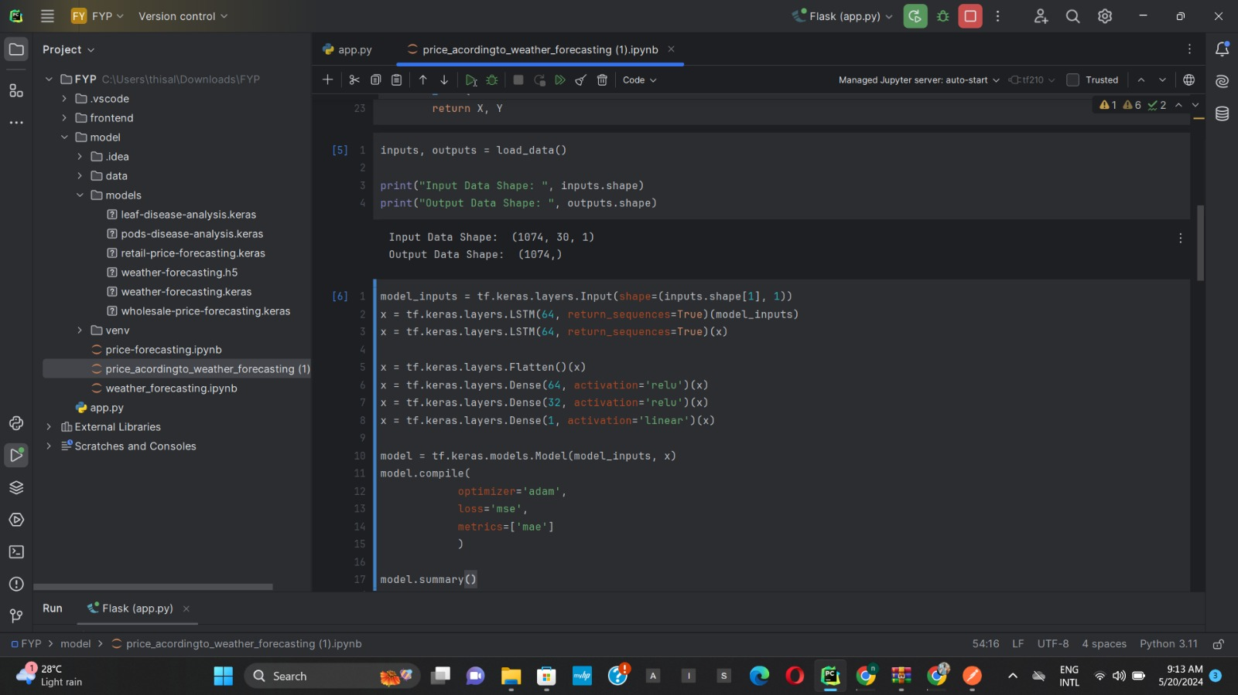
Model definition
IT20119362 | Bandara Higgoda T.T.S | 2023 - 24 - 103

Slide 15
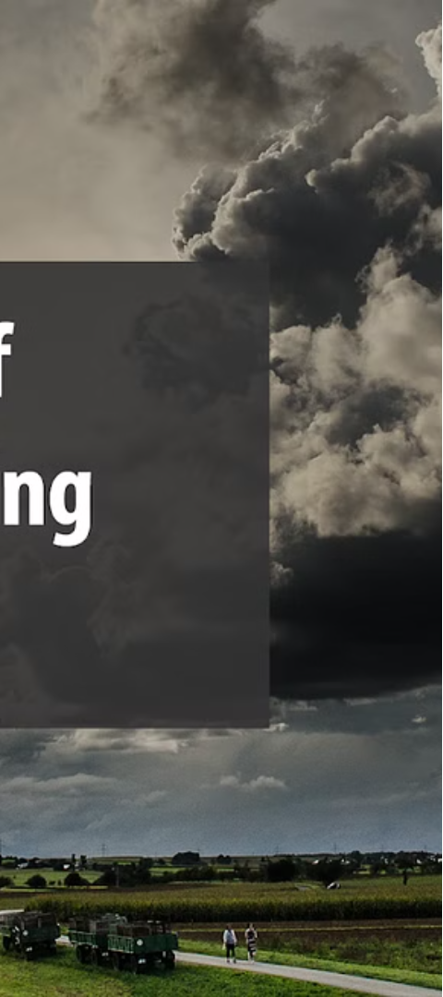
Weather Forecasting Module
Model Architecture
Integrate Weather Data
The weather forecasting model consists of a dense neural network architecture. It is designed to learn patterns and relationships from historical weather data to make accurate predictions.
The weather forecasting module integrates real-time weather data to analyze and predict optimal growing conditions for bean production, helping farmers make informed decisions.
IT20249502 | Devinda K.K.D | 2023 - 24 - 103

Slide 16
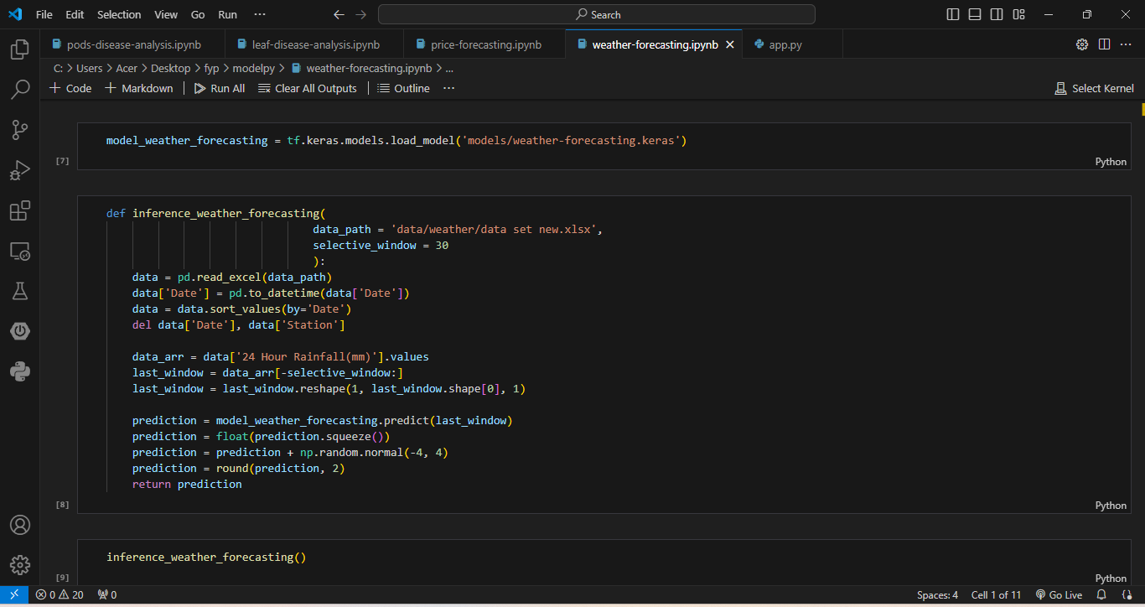
Model Loading and Prediction Functions for Weather Forecasting
IT20249502 | Devinda K.K.D | 2023 - 24 - 103

Slide 17
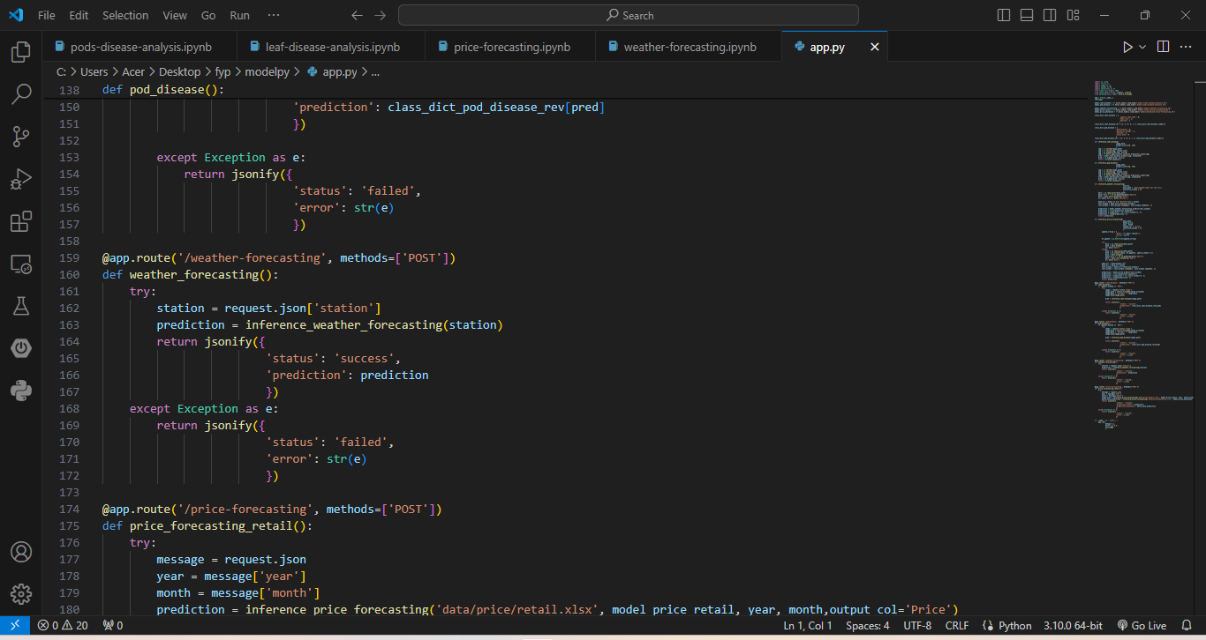
Flask API Endpoints for Weather Forecasting
IT20249502 | Devinda K.K.D | 2023 - 24 - 103

